Slide 1
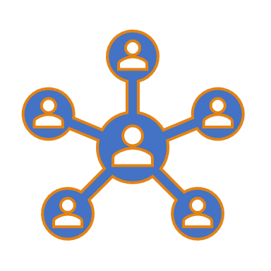
Student Networking Application
Dr. Ziad Kobti
University of Windsor
Presented by : Mounika, Hesha , Nizar and Adaobi
(Team -1)
Notes:
[ Hesha ]: Good Morning everyone, Hope all are doing fine. Today, my team( I, Mounika, Nizar and Adaobi), are here to present our project “ Student Networking Application” for Advanced Software Engineering course lectured by Dr Ziad Kobti.

Slide 2
Table of Contents
Business case/Vision,
Objectives of the project
System architecture
Implementation
Risk analysis
Summary
Notes:
Our goal for today is to present the details of our project such as
Business case/Vision,
Objectives of the project
System architecture
Implementation
Risk analysis
Summary

Slide 3
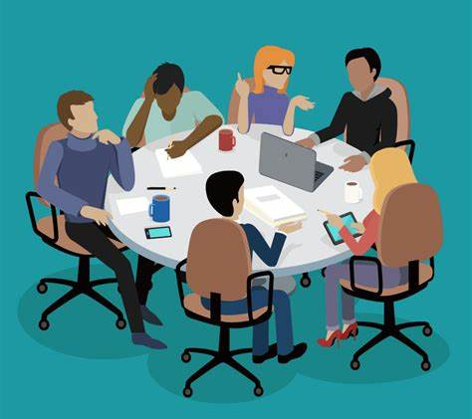
Missing fun activities in class ☹
[1]
Notes:
[ Hesha ] : Are you guys missing fun activities and discussions in class?? we know what's the pain of studying online and meeting no friends ?
Connect to your Classmates! is our main goal.University of Windsor Students will get chance to connect to fellow students virtually ! What’s more exciting that online studies are fun but what’s more fun is that you can create your own events Sounds Interesting right !
Let’s have a look at our business case and vision.

Slide 4

Business Case and Vision
Business Case
Reason - To provide students online networking platform
Benefits - Conduct group meetups and have fun activities
Time Scale - To implement in 50 days.
Budget - Use online free software for students and our laptops for implementation.
Vision: To provide a virtual environment for students of Windsor to communicate with peer students. Further, to discuss and share information regarding a topic or event.
Notes:
[ Hesha ] : Business case and Vision
The current Covid -19 pandemic as the classes are online and everyone is studying is virtually , it becomes difficult for new students to communicate in the new environment especially international students . Students miss the opportunity to create networks and culture of the university .Also , it becomes awkward sometimes to message someone randomly . To overcome issues like this we have thought of platform where all students can share their and get to know others having similar thoughts.
The vision is simple to provide a virtual environment for students to communicate , discuss and share information regarding a topic or event with their peer students.

Slide 5
Objectives
Implement a discussion board that help the users of the application to create table and join existing tables to participate in the discussion or activity.
Develop a chat feature that help the participants to share their views if their audio or video is not functioning.
Display an events page which lists all the upcoming events happening in and around University of Windsor’s campus.
Develop a Login feature that allows only University of Windsor students to access the application.
Provide feedback form for the users to address their issues.
Notes:
[ Hesha ] Objectives of the project :
Implements a discussion board that helps users of the application to create a Table and join existing tables to participate in the discussion or activity.
Develop a chat feature that helps the participants to share their views if their audio or video is not functioning.
Display an events page which lists all the upcoming events happening in and around campus.
Develop a login feature which allows the only University of Windsor to access the application.
Provide a feedback form for the users to address their issues in the application.
Now, I would like my friend Mounika to speak about System Architecture.

Slide 6

Overview of System
System Design
Database
SQL- IBM DB2
Backup - Maintain frequent backups
API design - REST
Front end development
System Architecture Type - Client- Server Architecture
Platform - Node.js
Back end development
Language - Express and Node.js
Framework/server - IBM Cloud
Notes:
[ Mounika ] :The overview of system specifies details as follows
In this system, we are using IBM DB2 as database for storing and managing data. Also, our system follows Rest API design for the data operations. The architecture we adopted is client server architecture where Node.js acts as both client and server technology. However, Node.js uses express.js framework for front end development.

Slide 7
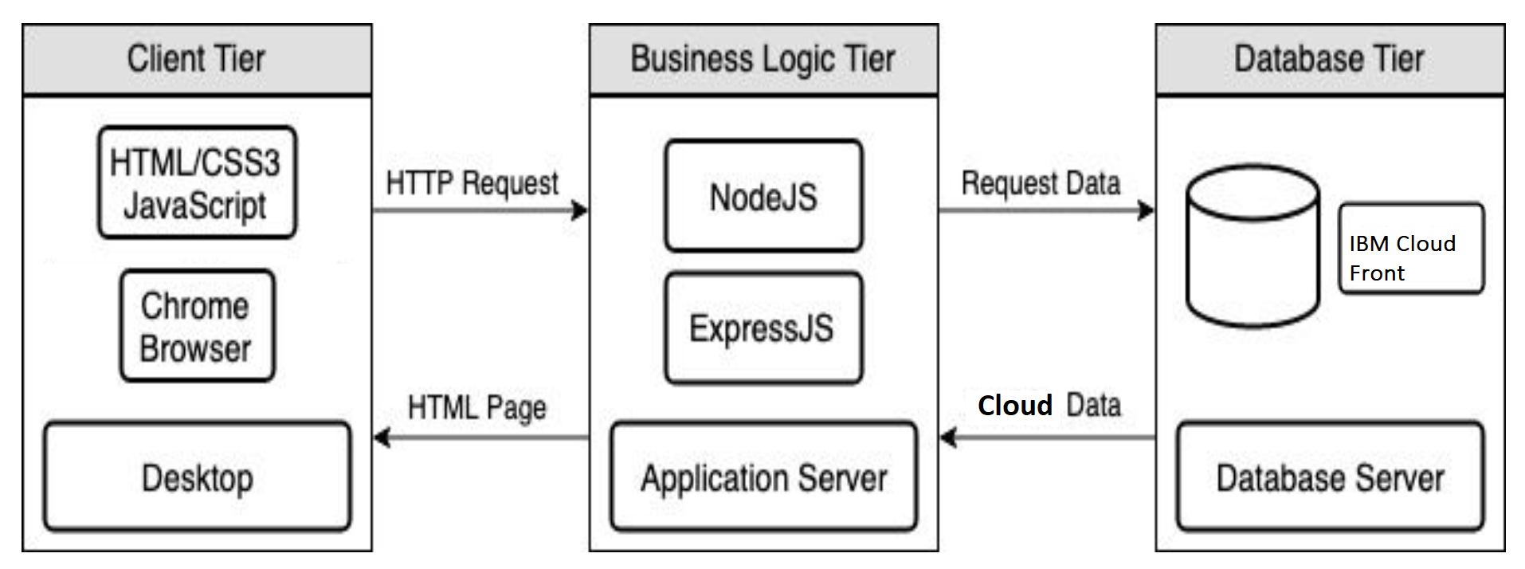
System Architecture
Notes:
[ Mounika ] : In this project , we are using Three tier architecture. We have Client, Business Logic and Database Tiers. In Client Tier, we have used HTML, CSS, JavaScript, chrome browser and desktop. Whereas, In Business Logic, we have Node.js , Express.js and Application server. In Database Tier, we have the database server. So, when client sends http request to Node.js then the Node.js will request data from the database on IBM Cloud. Then, the database server will send the data to Application server which then will be navigated to the browser for the client.

Slide 8
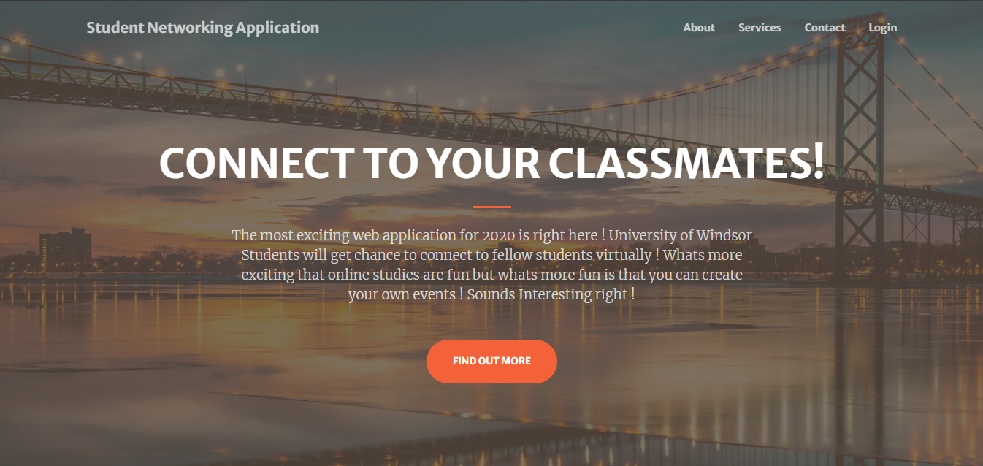
Home page
Notes:
[ Mounika ] :This is our first page of the application where we have all the features of the website listed like About, Services and Contact and Login. Here, the about link lets us navigate to the application information and Services link will move the part of the webpage where all the services provided are listed. Contact link navigates to contact page where the contact details are provided. Login helps us to login to the application and use its wonderful services.

Slide 9
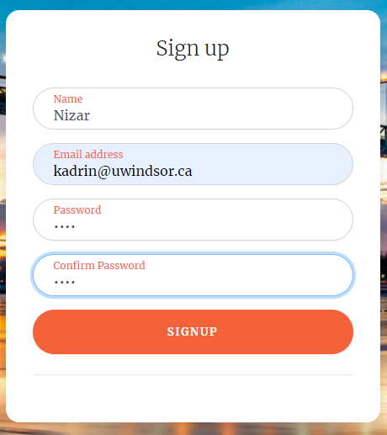
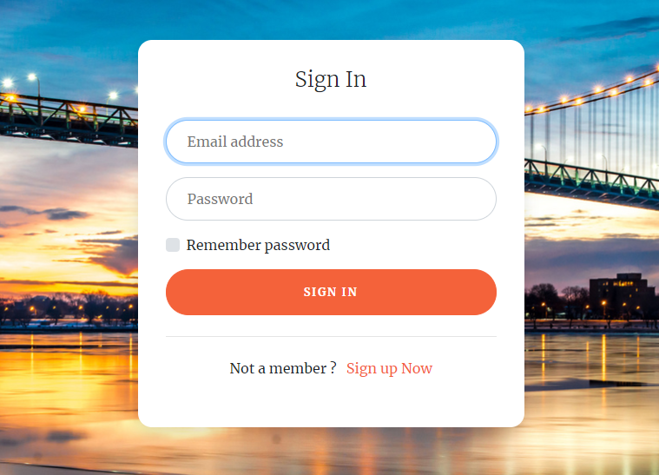
Sign In and Sign-up Pages
Notes:
[ Mounika ] : These are our projects Sign in and Sign up pages where users can first create their accounts with uwindsor email id and only could login once the account is activated through their email. Rest of the features will be shown by Adaobi.

Slide 10
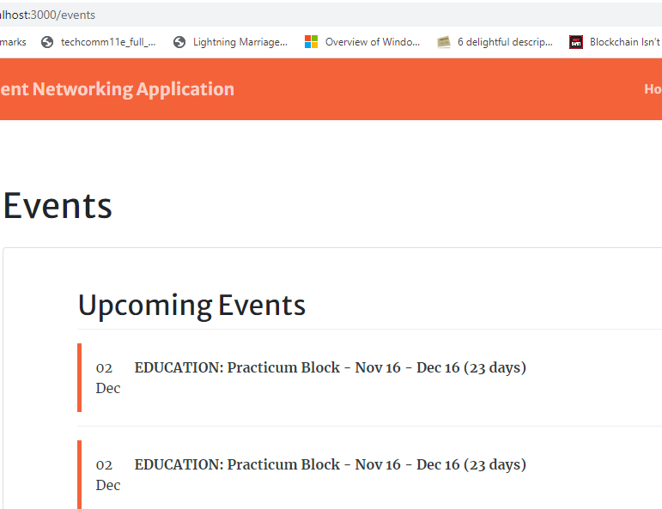
Events Page
Notes:
[ Adaobi ]: This is our events page where all the events taking place in and around campus will be listed here with the date and timings. Every morning, events will be fetched from University of Windsor website using cron job and gets stored in a file. The user can click on the tab of the event and the link will be redirected to University of Windsor Events details page.

Slide 11
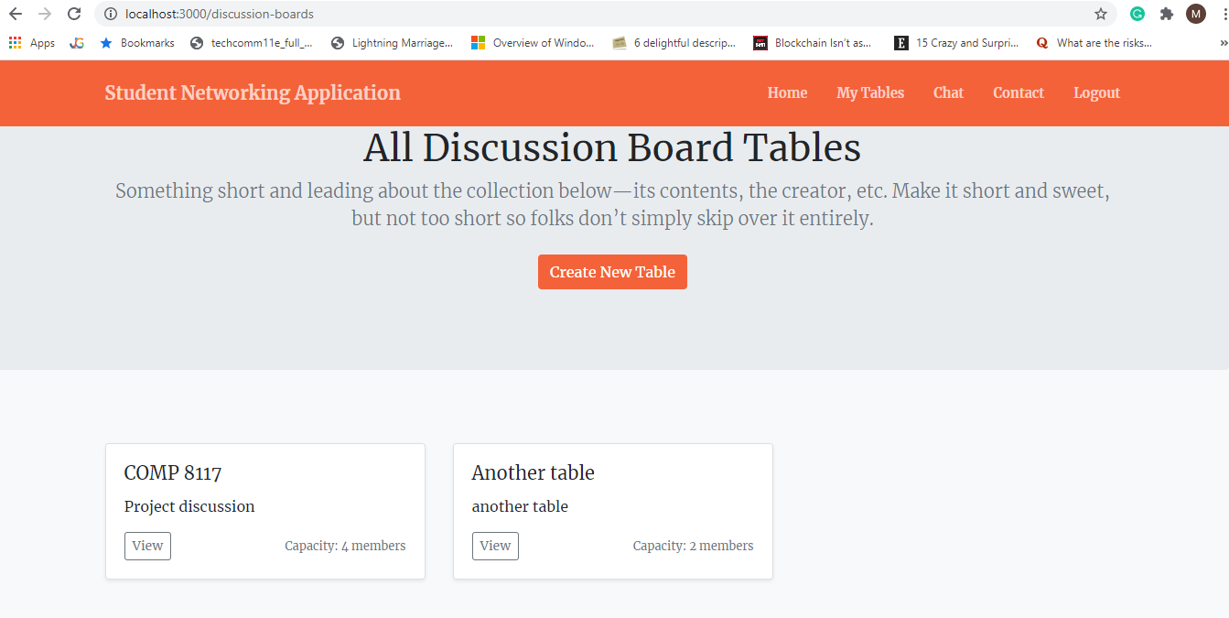
Discussion Board
Notes:
[ Adaobi ] :This is our discussion board where students will be allowed to create their own tables of their own interest. Any other users of the application can join the table.

Slide 12
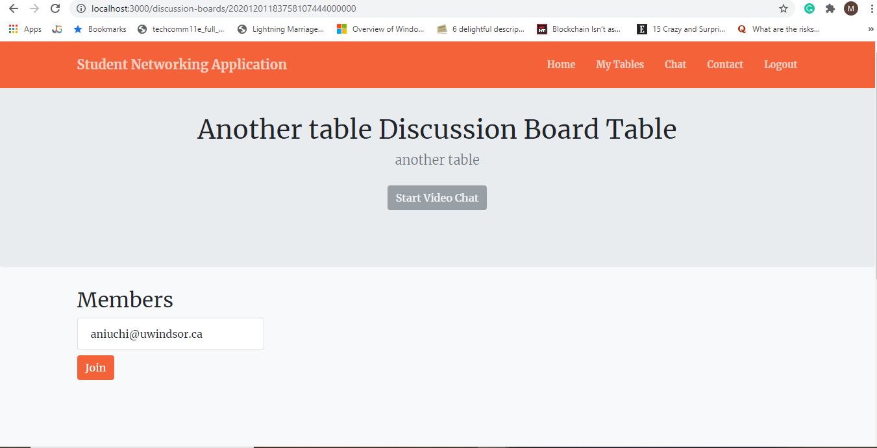
Table Details
Notes:
[ Adaobi ] :This is table details page where all table related information like table details and table members will be displayed

Slide 13
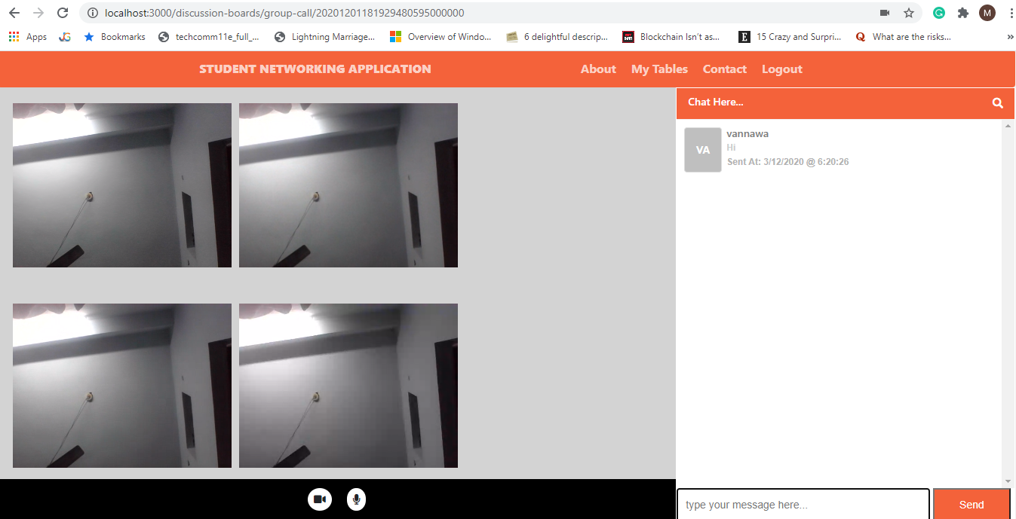
Video, Audio and Chat Features
Notes:
[ Adaobi ] : When the user clicks on start video chat button of table details page , all the users available online will be able to communicate by audio and video as well as chat facility.

Slide 14
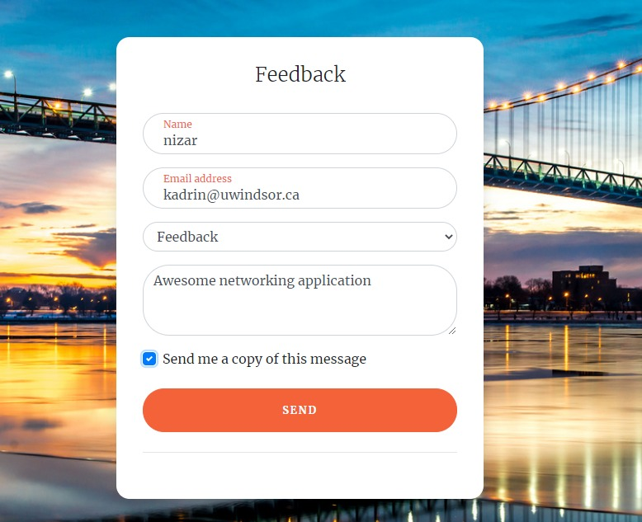
Feedback Form
Notes:
[ Adaobi ] :This is our feedback form of our application available to users of the application, where user can send their feedback on the application or raise any complains or concerns they are facing.

Slide 15
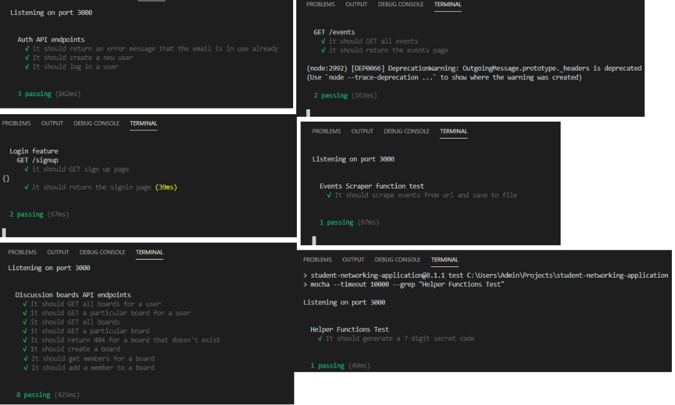
Unit Test cases using Mocha and Chai
Notes:
[ Nizar ] :We have used Mocha framework and Chai library to perform unit testing .We have used Test Driven Development to maintain the code quality.

Slide 16
Risks and how did we handle it ?
Development Complexity: Shifted from Completely Node.js application to Node.js with Express.js
Disguised Signups: Restricted access through the university mail id login
Data Confidentiality Issues: Used IBM DB2 on IBM cloud front to secure the data efficiently.
Misconduct issues: Added privacy policies , Terms of conditions and Usage.
Performance issues: Used web application standards to prevent application from hacking and crashing.
Notes:
[ Nizar ] :The risks of we faced in our application
1.Development Complexity : we shifted from completely node.js application to Node.js with Express.js
2.Disguised Signups : We created the website only for University of Windsor’s Students so we restricted the access through uwindsor email id.
3.Data Confidentiality Issues: We have used IBM DB2 on IBM Cloud front to secure the data efficiently.
4.Misconduct issues : we don’t want any misconduct of our website therefore we have added privacy policies , Terms of Conditions and Usage.
5.Performance issues : We have used web application standards to prevent application from hacking and crashing.

Slide 17

Summary of Project Management
Version Control using Gitlab
https://gitlab.cs.uwindsor.ca/ase_team1/student-networking-application/
Software Project Management using Redmine
https://redmine.cs.uwindsor.ca/projects/ase-team1
Team Communication using Zoom or TeamViewer.
Project Website (documentation): https://gitlab.cs.uwindsor.ca/ase_team1/student-networking-application/-/wikis
IBM Cloud Front (deployment)
Testing: Mocha framework and Chai library
Notes:
[ Nizar ]: The whole project is available on GitLab using the available link.
The project management tool we used is Redmine which is provided by the University of Windsor.
We communicated using Zoom and TeamViewer for sharing our ideas and work .
We have also created our project website.

Slide 18
References
[1] siod1616, “New Year Planning Meetings Done Right,” Vue Columbus, 20-Dec-2018. [Online]. Available: https://vuecolumbus.com/meeting-rooms/new-year-planning-meetings-done-right/. [Accessed: 02-Dec-2020].
Notes:
[ Nizar ] :This is our references used for the presentation.

Slide 19
Thank you
Any Question ?
Notes:
[ Nizar ] : Any Questions ? We want to thank Dr. Kobti for giving us this wonderful opportunity .Thank you everyone.

